Slide 1
Employee Turnover Analysis
Presented by: Qihan Liu, Yina Luo
Date: 3/3/2023

Slide 2
Is turnover a problem
YES!

Slide 3
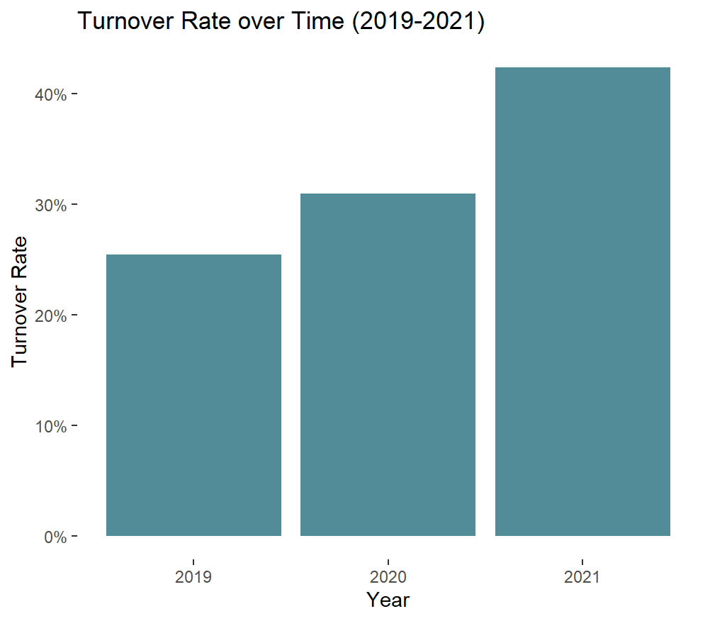
Analysis of the turnover rate
Employee turnover is increasing every year
2022Q1: 12.3%

Slide 4
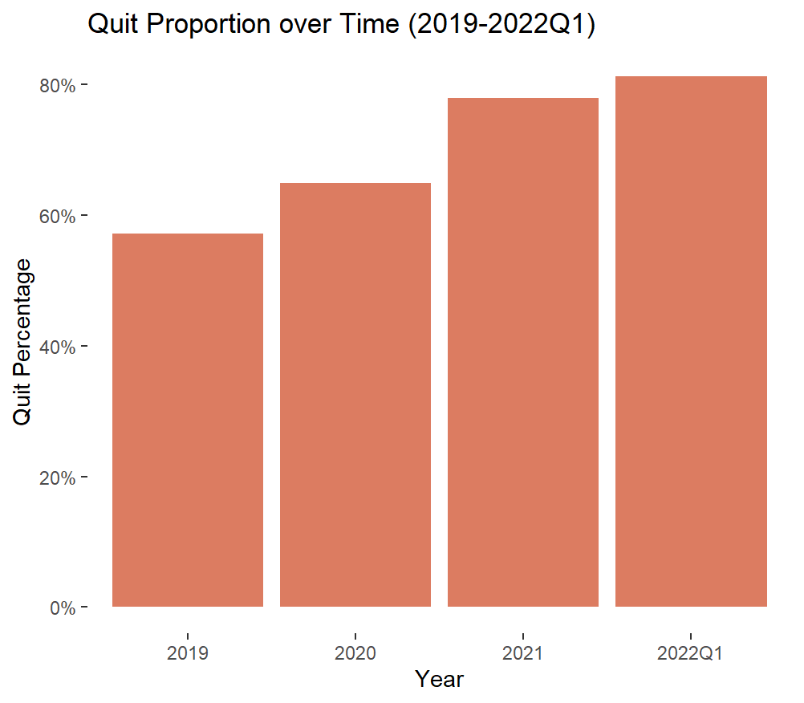
Quit proportion is increasing!
The proportion of employee quits in employees left has been increasing year by year.

Slide 5
What contributes high turnover rate?
Quit
Rating:
Performance rating increase by 1
(Performance rating: average performance rate in latest 3 evaluation)
Quit ratio decrease by 53%
Degree level:
Employee has master degree,
Quit ratio increase 49%

Slide 6
What contribute high turnover rate?
Fired
Age:
Age goes up by 1 year
Fired ratio decrease by 1%
Rating:
Performance rating goes up by 1
Fired ratio decrease by 66%

Slide 7
SUGGESTION
We should pay more attention to employee quits, as they take a larger and growing portion of overall turnover.
In further work, we could provide assistance to low performing employees based on the performance rating, such as additional training opportunities, or in-person coaching sessions

Slide 8
SUGGESTION
To encourage employees with poor performance to stay, we also suggest offering incentives or rewards for improvement, addressing any underlying issues that may be contributing to their poor performance.
Employees with higher levels of education may leave due to a mismatch between their job and qualifications, therefore HR should place greater emphasis on aligning job requirements with education levels during the recruitment process.

Slide 9

Thanks!

